Slide 1

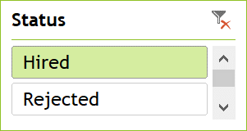
HIRING ANALYSIS
This data shows gender wise distribution how many male and female are been hired by the company.

Slide 2

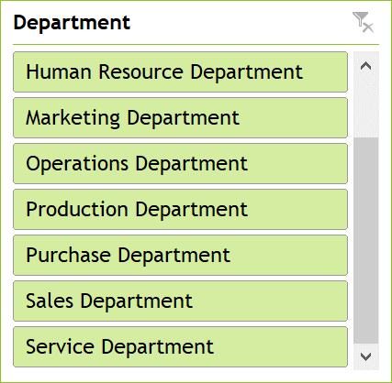
SALARY ANALYSIS
The average salary offered by the company for the employees is been distributed as department wise.

Slide 3

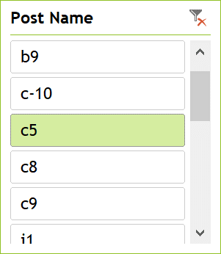
DEPARTMENTS ANALYSIS
This data shows the positions in which the employees work in different departments within the organization.

Slide 4
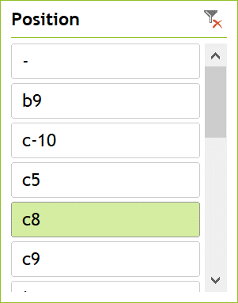
POSITION TIRE ANALYSIS
This data represents department wise distribution of position that are been offered by the organization to the employees.

Slide 5
INTERVIEW DATE ANALYSIS
This data showcase the analysis of hiring and rejection rate for the month of May, June , July, August

Slide 6
INTERVIEW METRIC
This data represents the number of interviews conducted by the organization to the employees in different department.

Slide 7
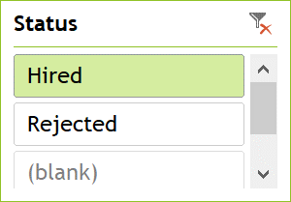
DEPARTMENT HIRING TRENDS
Based on the analysis this data represents the hiring tends of various departments and gender wise hiring with in the organization.

